Slide 1
Solutions & Stoichiometry

Slide 2
Solutions
In chemistry, a solution is a special type of homogeneous mixture composed of two or more substances.
In all solutions, whether gaseous, liquid, or solid, the substance present in the greatest amount is the solvent, and the substance or substances present in lesser amounts are the solute(s).
The solute does not have to be in the same physical state as the solvent, but the physical state of the solvent usually determines the state of the solution.
As long as the solute and solvent combine to give a homogeneous solution, the solute is said to be soluble in the solvent.

Slide 3
Types of solutions
Solutions can be classified based either on:
Single or biphasic solution, OR
The solvent used for making the solution

Slide 4
Types of solutions
Solutions can be classified based on:
Single or biphasic solution:
Homogeneous solution- solute is completely miscible with solvent to give a single phase solution.
Heterogeneous solution- solute is immiscible with solvent to give a biphasic solution.

Slide 5
Types of solutions
Solutions can be classified based on:
The solvent used for making the solution:
Solvent used could be:
Gas, OR
Liquid, OR
Solid

Slide 6
Types of solutions
Gaseous solutions: In this case the solvent is gas
Solute | Solvent | Example
Gas | Gas | Air (oxygen and other gases dissolved in nitrogen)
Liquid | Gas | Fog
Solid | Gas | Smoke

Slide 7
Types of solutions
Liquid solutions: In this case the solvent is liquid
Solute | Solvent | Example
Gas | Liquid | Carbonate beverages Dissolved oxygen in water
Liquid | Liquid | Alcoholic beverages (ethanol in water)
Solid | Liquid | Sucrose (table sugar) in water, Sodium chloride (NaCl) (table salt) or any other salt in water

Slide 8
Types of solutions
Solid solutions: In this case the solvent is solid
Solute | Solvent | Example
Gas | Solid | Hydrogen dissolves rather well in metals, especially in palladium, H₂/Pd
Liquid | Solid | Mercury in gold, forming an amalgam Water in solid salt or sugar, forming moist solids Hexane in paraffin wax
Solid | Solid | Alloys: brass, bronze, steels

Slide 9
Properties of solutions
Colligative properties of solution: Properties of solution that depends on the number of dissolved particles or solute and not the type of solute are colligative properties of solution. Major colligative properties are:
Lowering of Vapor Pressure
Boiling point elevation
Freezing point depression
Osmotic pressure

Slide 10
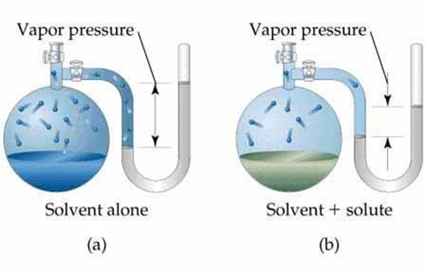
Properties of solutions
Colligative properties of solution: a. Lowering of Vapor Pressure:
The vapor pressure of a solution will always be lower than that the vapor pressure of a pure solvent.

Slide 11
Properties of solutions
Colligative properties of solution: a. Lowering of Vapor Pressure:
The pressure exerted by the vapors of a liquid is known as vapor pressure.
Vapor pressure is a surface phenomenon and it depends on the surface area of the liquid.
The vapor pressure of a solution will always be lower than that the vapor pressure of a pure solvent.
The extent to which the vapor pressure is lowered depends on the amount of solute present in the solution.

Slide 12
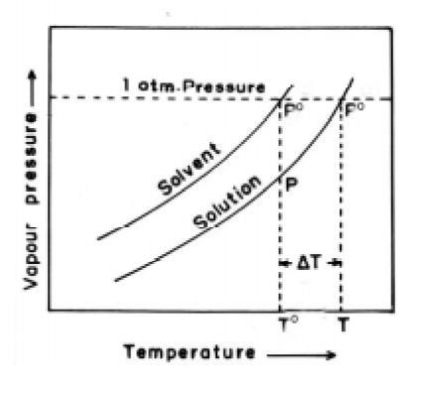
Properties of solutions
Colligative properties of solution: b. Boiling point elevation:
Boiling point of solution is always higher than the boiling point of pure solvent.

Slide 13
Properties of solutions
Colligative properties of solution: b. Boiling point elevation:
Boiling point is the temperature at which vapor pressure is equal to atmospheric pressure.
Since, vapor pressure of solution is always lower than the vapor pressure of pure solvent, boiling point of solution is always higher than the boiling point of pure solvent.

Slide 14
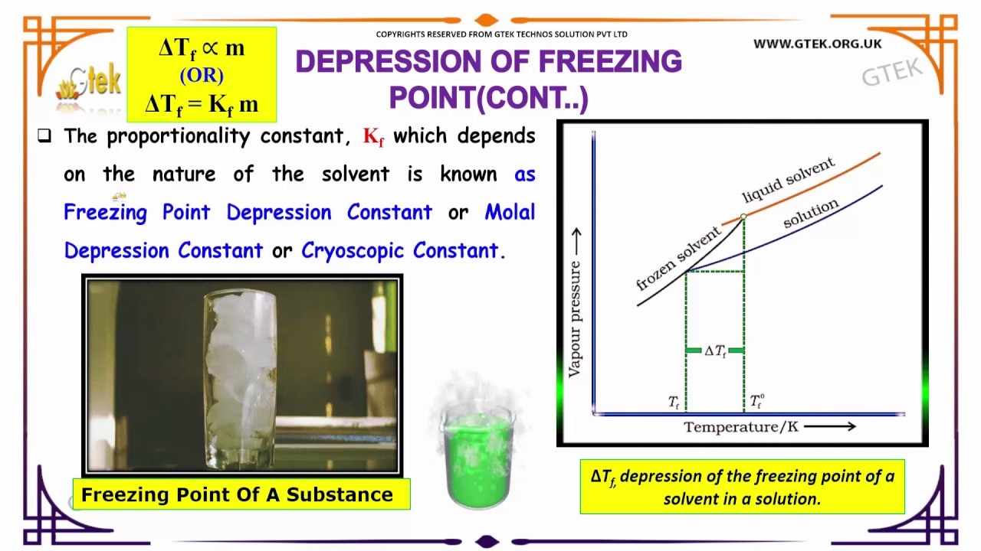
Properties of solutions
Colligative properties of solution: c. Freezing point depression:
The freezing point of solution is always lower than the freezing point of pure solvent.

Slide 15
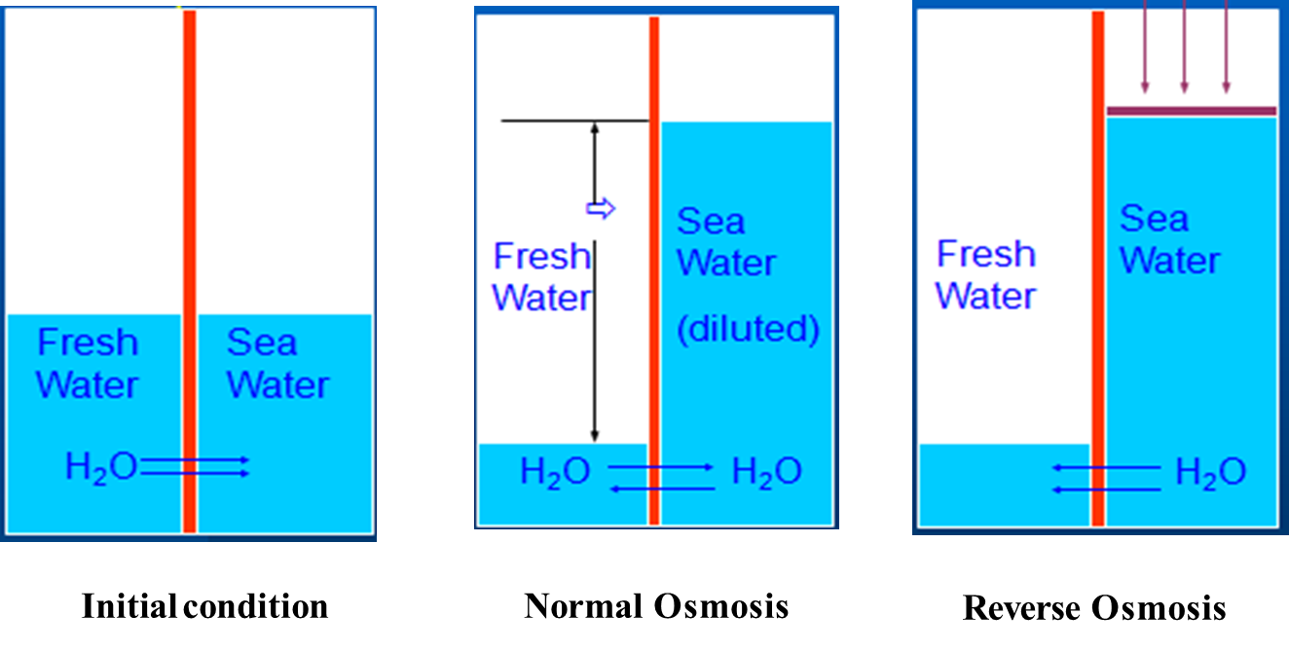
Properties of solutions
Colligative properties of solution: d. Osmotic pressure:

Slide 16
Properties of solutions
Colligative properties of solution: d. Osmotic pressure:
Osmosis: When two solutions of unequal concentration are separated by a semi-permeable membrane, the flow of solvent occurs from dilute solution to concentrated solution.
Reverse Osmosis: If external pressure is applied on the concentrated solution side, the solvent flow reverses, i.e. solvent is forced to flow from concentrated to dilute side.

Slide 17
Properties of solutions
Colligative properties of solution: d. Osmotic pressure:
Osmotic pressure is the minimum pressure which needs to be applied to a solution to prevent the inward flow of water across a semipermeable membrane.
It is also defined as the measure of the tendency of a solution to take in water by osmosis.
The more the amount of solute in the solution, the greater will be the osmotic pressure required to prevent the inward flow of water across the semipermeable membrane

Slide 18
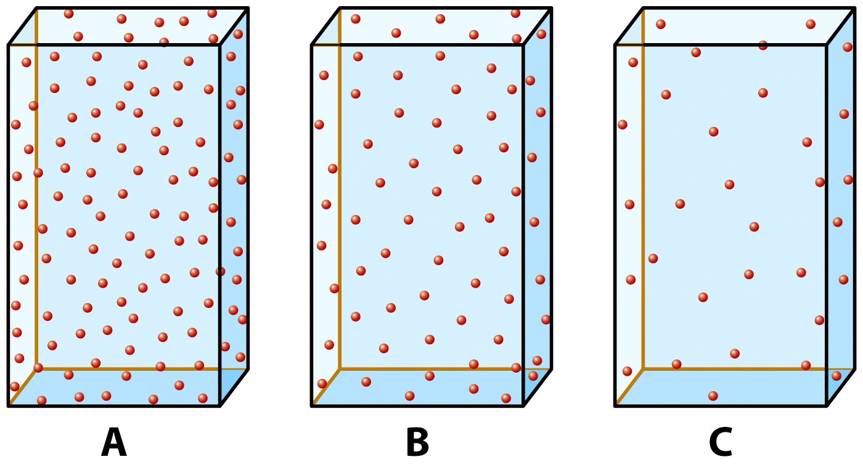
Concentration - the amount of substance
The concentration above decreases as A > B > C

Slide 19
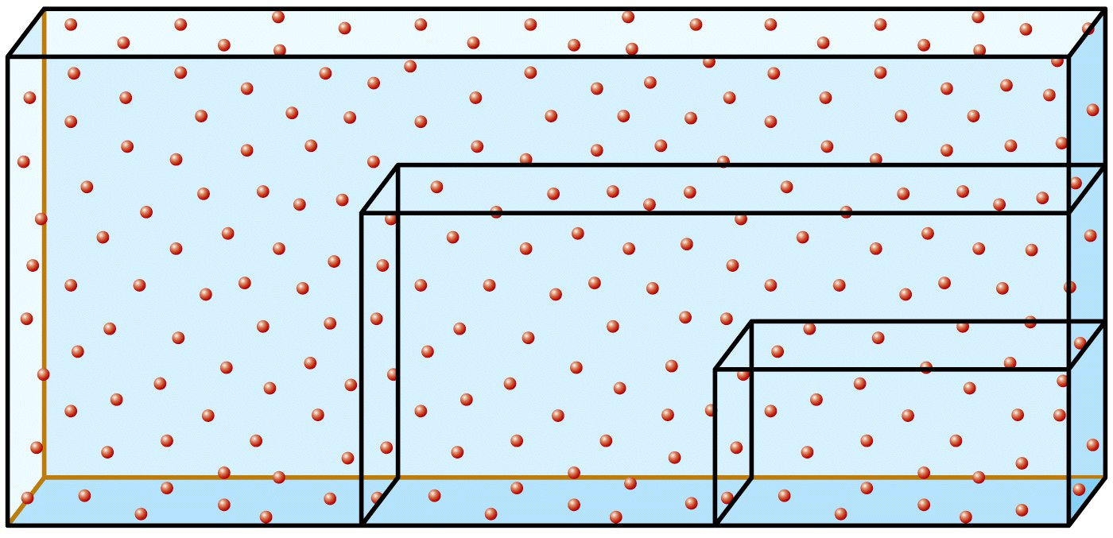
Concentration of homogenous solutions
In homogenous solutions the concentration of the solution is independent of its volume, concentration is uniform throughout the solution

Slide 20
Biological importance of concentration
The fluid balance of the body depends on the concentration of the blood components
Many enzymes depend on certain metal ions for their proper functioning. If the concentration of these metal ions is low the enzyme functioning is impaired
Effectiveness of drugs depends on their concentration in the blood
If the concentration of the drug is too high there will be toxic side effects
If the concentration of the drug is too low, it will be ineffective

Slide 21
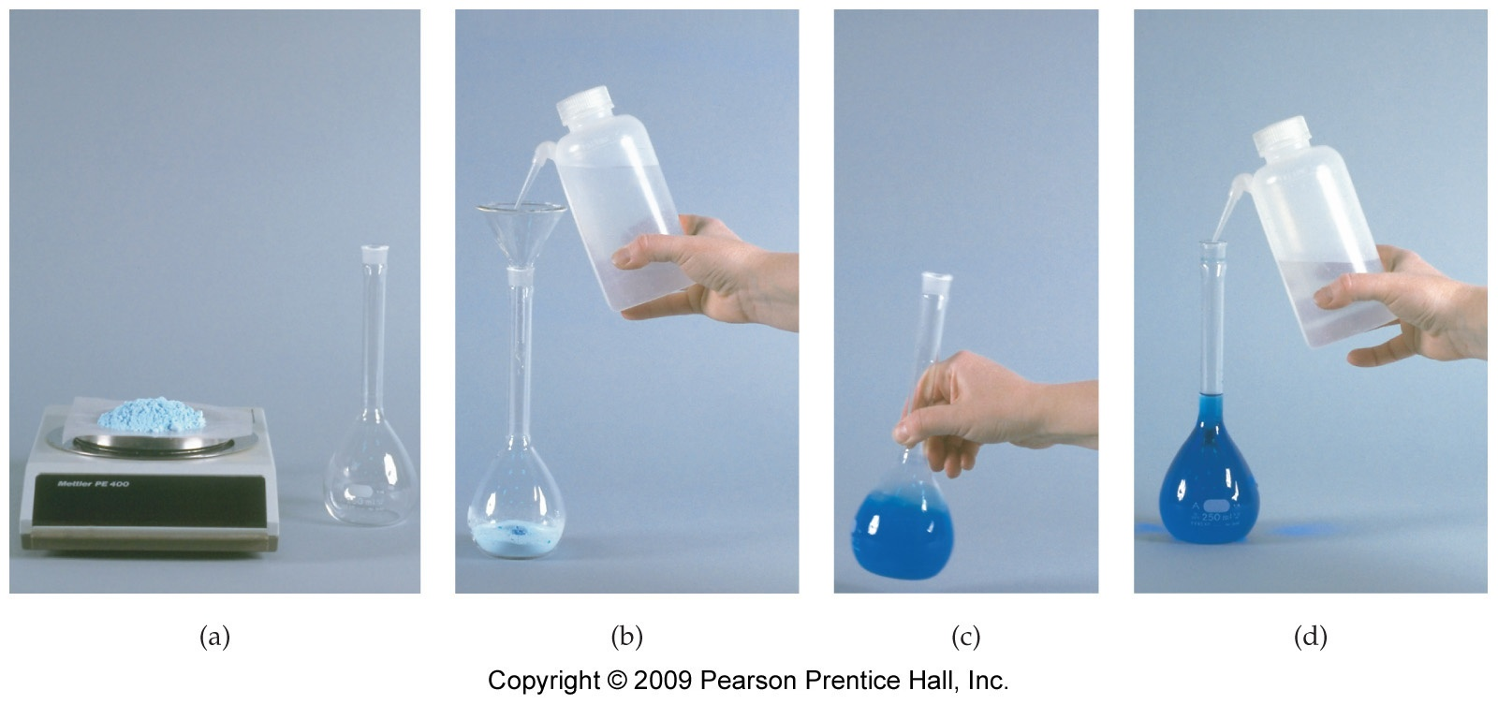
Preparing a solution of known concentration

Slide 22
Concentration (various units)
Concentration is the amount of solute present in a specified amount of solvent or solution.
Major units of concentration are:
ppm (parts per million)
ppb (parts per billion)
Molarity
Normality
Molality

Slide 23
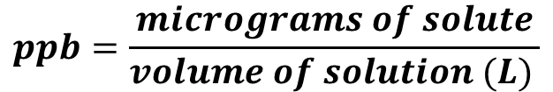
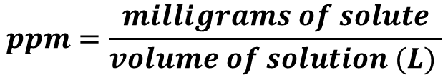
Concentration (ppm & ppb)
In solution, parts per million (1 part in 10⁶ parts) is defined as the milligrams (10^{─3} g) of solute per litre of solution.
In solution, parts per billion (1 part in 10⁹ parts) is defined as the micrograms (10^{─6} g) of solute per litre of solution.
Conversion between ppm and ppb is: 1 ppm = 1000 ppb; 1ppb = 10^{─3} ppm
$$ppm=\frac{milligrams of solute}{volume of solution (L) }$$
$$ppb=\frac{micrograms of solute}{volume of solution (L) }$$

Slide 24
Concentration numerical
Problem 1: 0.03 Kg NaCl is dissolved in H₂O to make volume of solution as 300 ml. Calculate the concentration of NaCl in the solution in terms of ppm and ppb.
Solution: Amount of NaCl = 0.03 kg = 30 g = 30000 mg Volume of solution = 300 ml = 0.3 L
concentration = 30000 mg/ 0.3 L = 10⁵ mg/L = 10⁵ ppm
= 10⁵ x 1000 ppb (Since 1 ppm = 1000 ppb)
= 10⁸ ppb

Slide 25
Concentration numerical
Problem 2: How much NaCl will you take to prepare a 250 ppm solution having volume of 200 ml.
Ans. 50 mg NaCl

Slide 26
Concentration numerical
Problem 3: A solution was prepared by dissolving 0.4 moles MgSO₄ in water such that total volume of solution is 300 ml. Calculate concentration in ppm. [Atomic weight: Mg=24, S=32, O=16]
Ans. 160000 ppm

Slide 27
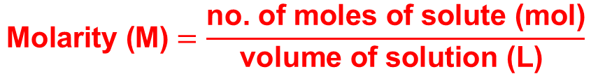
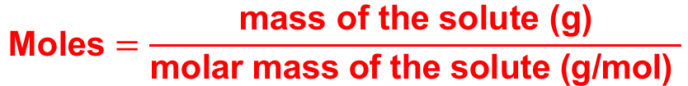
Expressing concentration in terms of molarity
Concentration (molarity)
Molarity is a measure of the concentration and is based on chemical mass units
Molarity is defined as the number of moles of the solute dissolved per liter of solution (not solvent)
The symbol for this type of concentration unit is “M”
Example, a 2.0 M solution of glucose means 2.0 moles of glucose are dissolved in 1.0 L of solution
$$\text{Molarity}\text{ (}\text{M}\text{)}=\frac{\text{no}\text{. }\text{of} \text{moles} \text{of} \text{solute} \text{(}\text{mol}\text{)}}{\text{volume} \text{of} \text{solution} \text{(}\text{L}\text{) }}$$
$$\text{Mol}\text{es}=\frac{\text{mass} \text{of} \text{the} \text{solute}\text{ (}\text{g}\text{)}}{\text{molar} \text{mass} \text{of} \text{the} \text{solute}\text{ (}\text{g}\text{/}\text{mol}\text{) }}$$

Slide 28
Concentration numerical
What mass of KCl (g) will be required to prepare 600 mL of 2.2M aqueous solution of KCl ?
(Hint: 2.2M KCl solution = 2.2 moles of KCl in 1000 mL i.e. 1L solution)
Ans. 196.6 g KCl

Slide 29
Concentration numerical
What is the molarity (M) of a MgBr₂ solution in which 144 g of MgBr₂ is dissolved in 500 mL of the solution?
(Molarity = no. of moles per liter of the solution)
Ans. 1.56 M

Slide 30
Concentration (normality)
$$\text{Equivalent} \text{weight} =\frac{\text{molar} \text{mass} \text{of} \text{the} \text{solute} }{\text{net} \text{charge} \text{on} \text{the} \text{cation} \text{or} \text{the} \text{anion}}$$
$$\text{no}\text{. }\text{of} \text{gram} \text{equivalents} \text{of} \text{solute} \text{(}\text{equiv}\text{)}=\frac{\text{mass} \text{of} \text{the} \text{solute} \text{(}\text{g}\text{)}}{\text{equivlent} \text{weight} \text{of} \text{the} \text{solute}\text{ (}\text{g}\text{/}\text{equiv}\text{)}}$$
$$\text{Normal}\text{ity}\text{ (}\text{N}\text{)}=\frac{\text{no}\text{. }\text{of} \text{gram} \text{equivalents} \text{of} \text{solute} \text{(}\text{equiv}\text{)}}{\text{volume} \text{of} \text{solution} \text{(}\text{L}\text{) }}$$

Slide 31
Concentration numerical (normality)
Calculate the normality of a NaOH solution prepared by dissolving 0.2 g NaOH to make a 250 ml solution.
Ans. 0.02 N

Slide 32
Concentration normality numerical
Calculate the normality of a Ca(OH)₂ solution prepared by dissolving 0.2 g Ca(OH)₂ to make a 250 ml solution.
Ans. 0.022 N

Slide 33
Concentration molarity & normality numerical
A Solution of Na₂CO₃ in water having concentration of 2000 ppm of total volume of 200 ml. Calculate the concentration in molarity and normality.
Ans. 0.019 M, 0.038 N

Slide 34
Concentration (molality)
Molality (m) is a property of a solution and is defined as the number of moles of solute per kilogram of solvent.
The SI unit for molality is mol/kg
A solution with a molality of 3 mol/kg is described as a “3 molal” or “3 m” solution.

Slide 35
Concentration
If we weigh 5.36 g of KCl and dissolve this solid in 56 mL of water, what is the molality of the solution?
Ans. 1.28 m

Slide 36
Concentration
A sulphuric acid solution containing 571.4 g H₂SO₄ per litre of solution has a density of 1.329 g/ml. Calculate molality of H₂SO₄ in this solution.
Ans. 7.69 m

Slide 37
Concentration
A solution was prepared by dissolving 20 g CaCl₂ in water such that total volume of solution is 200 ml. Density of solution=1.1 g/ml. Calculate concentration in molality. [Atomic weights: Ca=40, Cl=35.5]
Ans. 0.9 m

Slide 38
Concentration
Calculate concentration in molality of 0.8 M solution of CaSO₄. Density of solution= 1.2 g/ml. Atomic weights: Ca=40, S=32, O=16]
Ans. 0.733 m

Slide 39
Mole fraction
The mole fraction, X, of a component in a solution is the ratio of the number of moles of that component to the total number of moles of all components in the solution.
To calculate mole fraction, we need to know the number of moles of each component present in the solution.

Slide 40


Mole fraction
The mole fraction of A, X_{A}, in a solution consisting of A, B, C, ... is calculated using the equation:
Similarly, mole fraction of B, X_{B}, can be calculated using the equation:

Slide 41
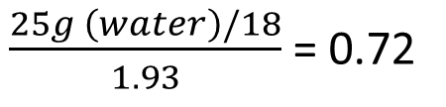
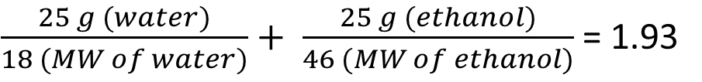
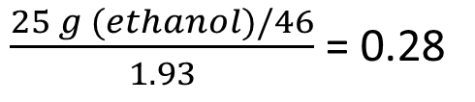
Mole fraction numerical
A solution is prepared by mixing 25 g water (H₂O), 25 g ethanol (C₂H₅OH). Calculate the mole fraction of each substance in the solution.
Solution: Total number of moles =
Mole fraction of water =
Mole fraction of ethanol =
$\frac{25 g (water)}{18 (MW of water)}+ \frac{25 g (ethanol)}{46 (MW of ethanol)}$ = 1.93
$\frac{25g \left(water\right)/18}{1.93}$ = 0.72
$\frac{25 g (ethanol)/46}{1.93}$ = 0.28
Note: When added together the mole fractions (weight fraction) of each component in the solution, the addition must equal one. Thus, X_{A} + X_{B} + X_{C} ……. = 1

Slide 42
Mass fraction
The mass fraction, Y, (or weight fraction) of a component in a solution is the ratio of the mass of that component to the total mass of all components in the solution.
To calculate mass fraction, we need to know the masses of each component present in the solution.

Slide 43
Mass fraction
The mass fraction of component A, Y_{A}, in a solution consisting of A, B, C, ... is calculated using the equation:
Similarly, mass fraction of B, Y_{B}, can be calculated using the equation:
Mass fraction Y_{A} = $\frac{mass of A}{mass of A +mass of B+ mass of C+ ……}$
Mass fraction Y_{B} = $\frac{mass of B}{mass of A +mass of B+ mass of C+ ……}$

Slide 44
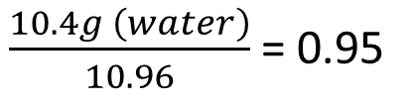
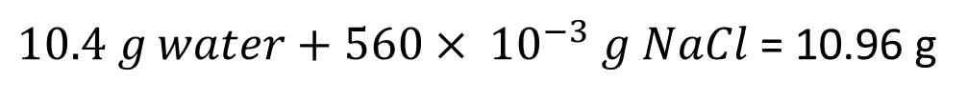
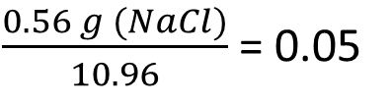
Mass fraction numerical
What is the mass fraction (weight fraction) of sodium chloride in an aqueous solution containing 560 mg of sodium chloride and 10.4 g of water?
Solution: Total mass =
Mass fraction of water =
Mole fraction of NaCl =
$10.4 g water+560× {10}^{−3} g NaCl$ = 10.96 g
$\frac{10.4g \left(water\right)}{10.96}$ = 0.95
$\frac{0.56 g (NaCl)}{10.96}$ = 0.05
Note: When added together the mass fractions (weight fraction) of each component in the solution, the addition must equal one. Thus, Y_{A} + Y_{B} + Y_{C} ……. = 1

